Slide 1
Outcomes and actions for… 1B Data Standards Workshop
20th – 21st March 2023, The Queens Hotel, Leeds
Workshop Leads:
Sophie Lowsley Architect - Interweave
Sophie.lowsley1@nhs.net
Lorraine Foley CEO - PRSB
Lorraine.Foley@theprsb.org
Liam King Healthcare Gateway
Liam.King@emisgroupplc.com

Slide 2
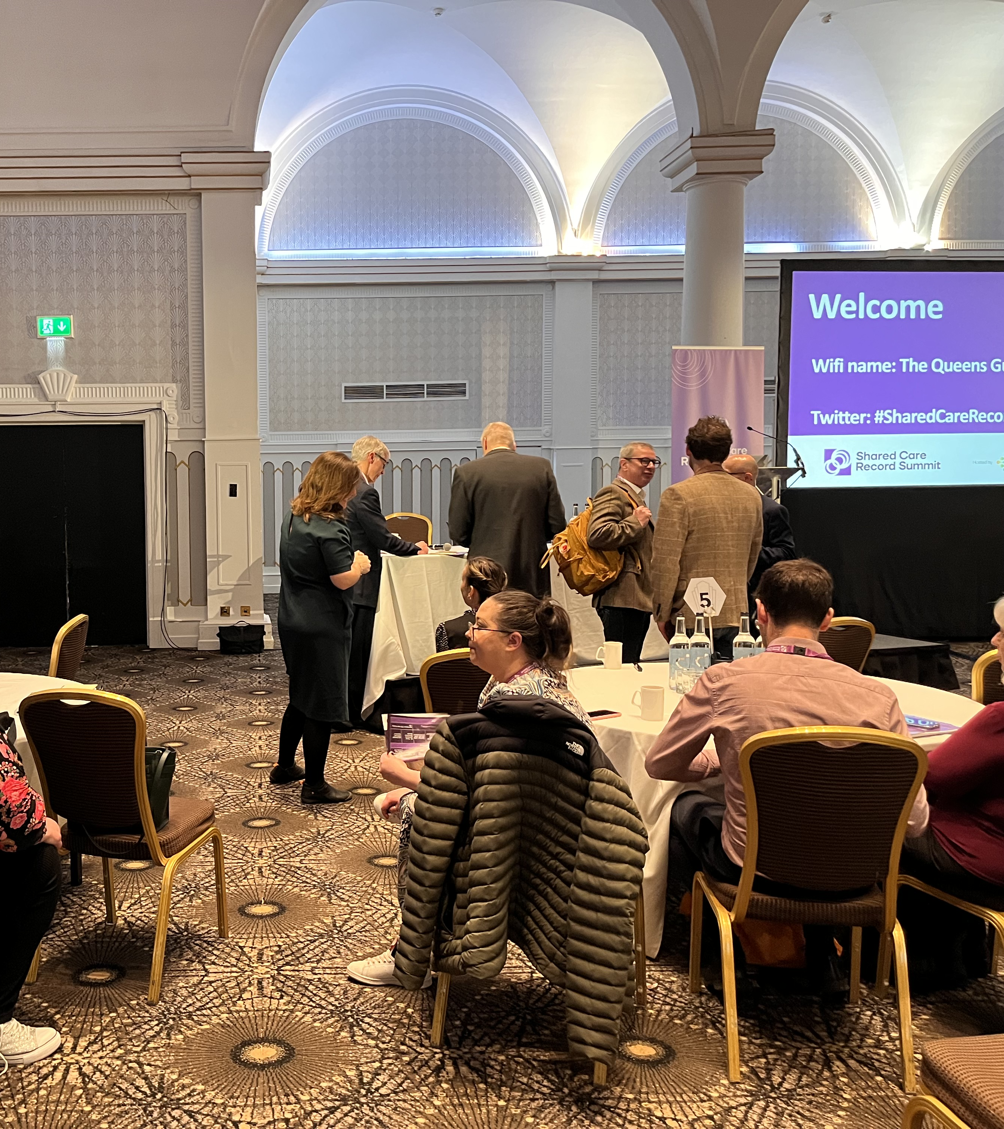
1B Data Standards
Great discussion and lively group
There is clearly a widely varying understanding of standards and their application – some of the basics need to be addressed and communicated widely and consistently in a compelling narrative – why, how, how will it help etc
ICS and partners wanting to take a far more proactive, united and influential role in determining common approaches but determining their own future and clarifying what they need of the centre

Slide 3
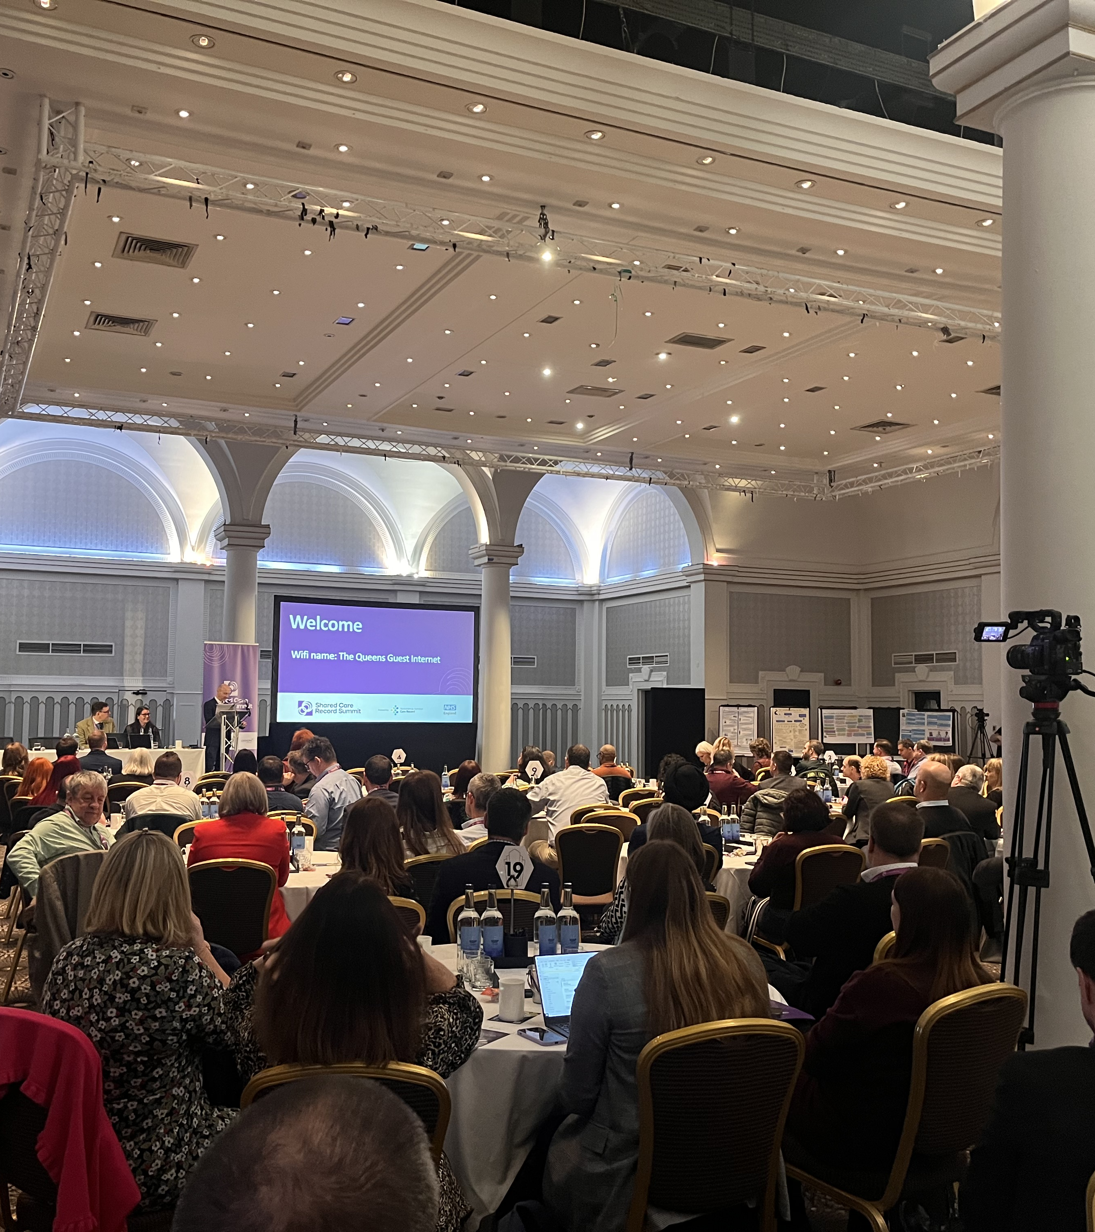
1B Goals:
1.Get suppliers conformant so that ICS and providers can be confident and interoperability is enabled
2.ICS to work with PRSB on what standards are needed
3.Define what the centre needs to provide (and what is not needed)

Slide 4
1B Detailed Outcomes & Actions
Action/Outcome | Who is involved? | Check in Date
How to understand data standards (How do we write better data standards) | Gill Foley – NHS E Phil Koczan – NHS E Ben Burch – NCL ICB Sarah Peel – NHS E
What are data standards (how do we get the message across about their importance) | Charles Frakes – Chesterfield Royal Hospital Robert Walker – Tech UK
Data standards exist but are not mandated (What can we do while legislation lands and understanding what the legislation cover) | Jo Bangoura – NHS E Paul Henderson – Channel 3 Paul Wye – Answer Digital Nichola Stephens – West Yorkshire ICS Julia Millman – Vitaldata Solutions David Broome – Stancliffe Pharmacy Ltd
Simplifying overly complex standards for use within the shared care record | Martin Wilson - Cheshire & Merseyside ICB/S Joss palmer – One London Nick Hopkinson - NHS E Emlyn Jones – SCW CSU
Consistent Application of data standards at source | Lesley Kitchen – Cheshire & Merseyside ICB/S John Gregg – EMIS Liam King – Healthcare Gateway Andrew Haw – Nottingham & Notts ICB
Covering the longitudinal record (health and social care) | Dan Hughes – NHS Sussex Steve Hulligan – Northampton ICS Raymond Hounon – Google Cloud Chris North – Pennine Care NHS Trust

