Slide 1
Outcomes and actions for… Workshop 2A - Road to Sustainability for ShCR
20th – 21st March 2023, The Queens Hotel, Leeds
Workshop Leads:
Joe McGuigan
Digital Operational and Assurance lead
Strategic Shared Care Record lead
VW and RM senior digital lead
Joe.mcguigan@nhs.net
David Corbett
Apira
One South West Programme
david.corbett@apira.co.uk

Slide 2
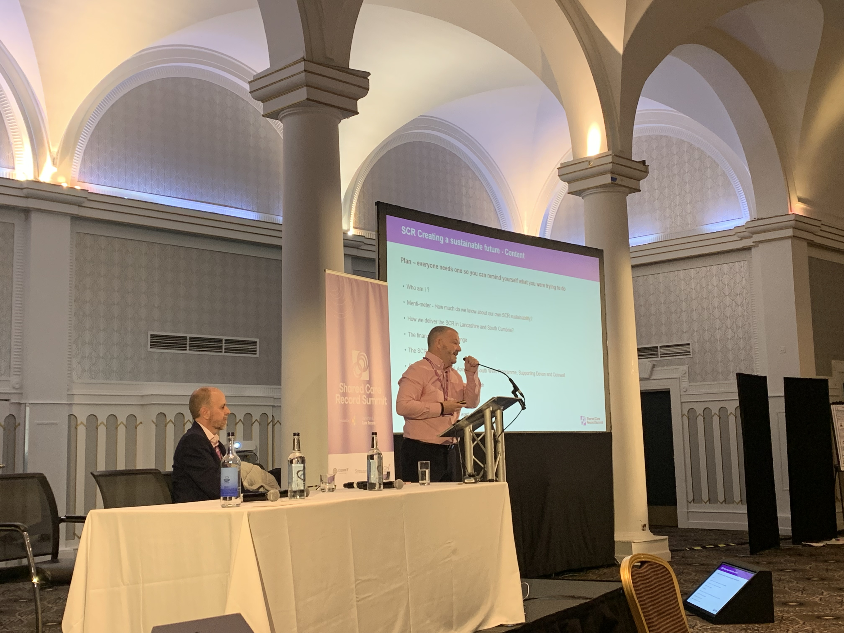
In summary:
A sustainable future presented by Joe addressed the current position on Shared Care Record sustainability and challenged how much we really understand about it and the requirements to keep momentum.
How do we translate the benefits to address the financial challenges.
David presented on a tried and tested model to support the challenges of MOU’s and how we need to work together to create a sustainability model.

Slide 3
Goals:
Please list the top 3 goals to take forward from your workshop
1. Establish an understanding of each ICB shared care record funding and sustainability; in a common way.
2. Share best practice for a sustainability model going forward.
3. Establish Shared Care Record Sustainability Network sub-group that can focus on actions to deliver 1 & 2.

Slide 4
Detailed Outcomes & Actions
Goals to take forward from ShCR workshop 2A – Creating a Sustainable Future for Shared Care Records:
Action/Outcome | Who is involved? | Check in Date
1. Establish an understanding of each ICB shared care record funding and sustainability; in a common way. Action: ShCR National Programme Director Group Ensure clarification from NHS England on funding and sustainability and procurement routes for ShCR. | NHS England ShCR National Programme Director Group | June 2023
2. Share best practice for a sustainability model going forward. Action: ShCR Summit Committee & NHS England to confirm how and where this information will be shared with ICBs. | NHS England ShCR Summit Committee ShCR National Programme Director Group | June 2023
3. Establish Shared Care Record Sustainability Network sub-group that can focus on actions to deliver 1 & 2 above. Action: ShCR National Programme Director Group to agree a Task & Finish group to work with ShCR Summit Committee and NHS England Shared Care Record Team to ensure appropriate contacts in ICBs can be reached and consistent platform is utilised to share sustainability information. | ShCR National Programme Director Group | June 2023

